Slide 1

COMPUTER NETWORKS
Animesh Giri
Department of Computer Science & Engineering

Slide 2

COMPUTER NETWORKS
Transport Layer
Animesh Giri
Department of Computer Science & Engineering

Slide 3

COMPUTER NETWORKS
Principles of reliable date transfer
Animesh Giri
Department of Computer Science & Engineering

Slide 4
In this segment
COMPUTER NETWORKS
Principles of reliable data transfer
Reliable data transfer: getting started
rdt1.0: reliable transfer over a reliable channel
Summary

Slide 5
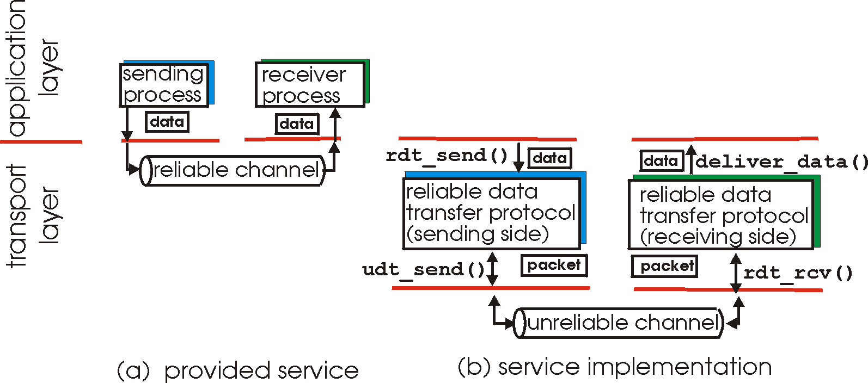
COMPUTER NETWORKS
Principles of reliable data transfer
important in application, transport, link layers
top-10 list of important networking topics!
characteristics of unreliable channel will determine complexity of reliable data transfer protocol (rdt)

Slide 6
COMPUTER NETWORKS
Principles of reliable data transfer
important in application, transport, link layers
top-10 list of important networking topics!
characteristics of unreliable channel will determine complexity of reliable data transfer protocol (rdt)

Slide 7
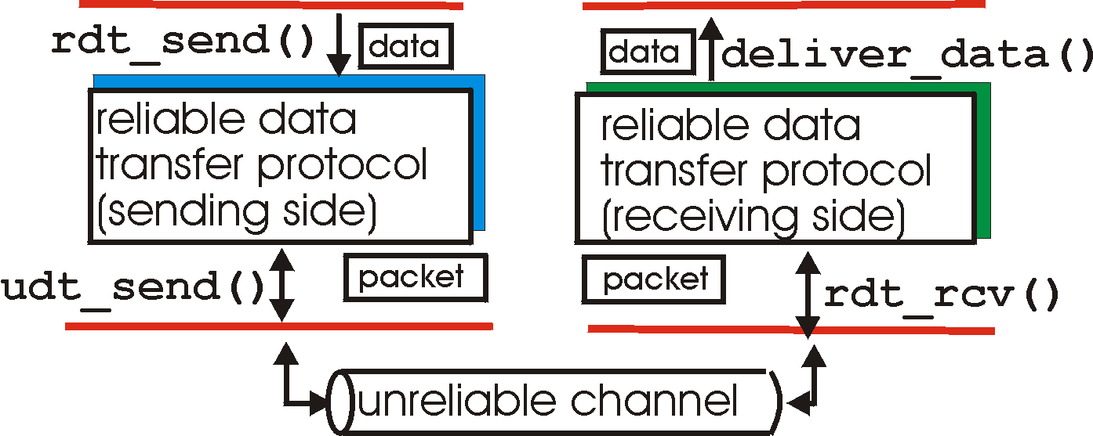
COMPUTER NETWORKS
Reliable data transfer: getting started
rdt_send(): called from above, (e.g., by app.). Passed data to
deliver to receiver upper layer
deliver_data(): called by rdt to deliver data to upper
send
side
receive
side
udt_send(): called by rdt,
to transfer packet over
unreliable channel to receiver
rdt_rcv(): called when packet arrives on rcv-side of channel

Slide 8
COMPUTER NETWORKS
Reliable data transfer: getting started
we’ll:
incrementally develop sender, receiver sides of reliable data transfer protocol (rdt)
consider only unidirectional data transfer
but control info will flow on both directions!
use finite state machines (FSM) to specify sender, receiver
event causing state transition
actions taken on state transition
state: when in this “state” next state uniquely determined by next event
state
1
state
2
event
actions

Slide 9
COMPUTER NETWORKS
rdt1.0: reliable transfer over a reliable channel
underlying channel perfectly reliable
no bit errors
no loss of packets
separate FSMs for sender, receiver:
sender sends data into underlying channel
receiver reads data from underlying channel
Wait for call from above
rdt_send(data)
Wait for call from below
rdt_rcv(packet)
extract (packet,data)
deliver_data(data)
packet = make_pkt(data)
udt_send(packet)
sender
receiver

Slide 10
COMPUTER NETWORKS
Summary

Slide 11
THANK YOU
Animesh Giri
Department of Computer Science & Engineering
animeshgiri@pes.edu
+91 80 6618 6603

